Slide 1
S9. Economics of Environment Conclusion I
Xavier Timbeau
Anissa Saumtally

Slide 2
In order to make 10b people live well on one planet we need to :
consume much better, i.e. with some sufficiency
price system will leave no choice
norms will provide infrastructure
Education will help
recycle everything that is in limited quantity
Technology will help
+ all preceding levers
find a way to produce energy without fossil fuel
fossil fuel is limited and poisonous
energy is coming from the sky, more than we need
we can imagine crazy sources for energy : nuclear fusion, clean nuclear fission
After all, CO₂ is not the (only) main problem

Slide 3
Remember, climate is one of many boundaries
Phosphorous cycle, Nitrate Cycle
Modern agriculture is an open loop
putting fertilizer on the soil (from mining&energy)
releasing it into the sea (through erosion and waste management)
Pollution absorption by ecosystem
Sad story of Caspian Sea, Aral Sea. Tomorrow of Mediteranean sea
Water cycle
Linked to change in climate
Linked to pollution
Needed for the agricultural loop
Biodiversity and biomass
Natural renewable resource exploited above reproduction threshold
Fishes, forests
Depletion of mineral and fossil resources
All cycles are open, we are not able to recycle anything !
Cradle to cradle

Slide 4
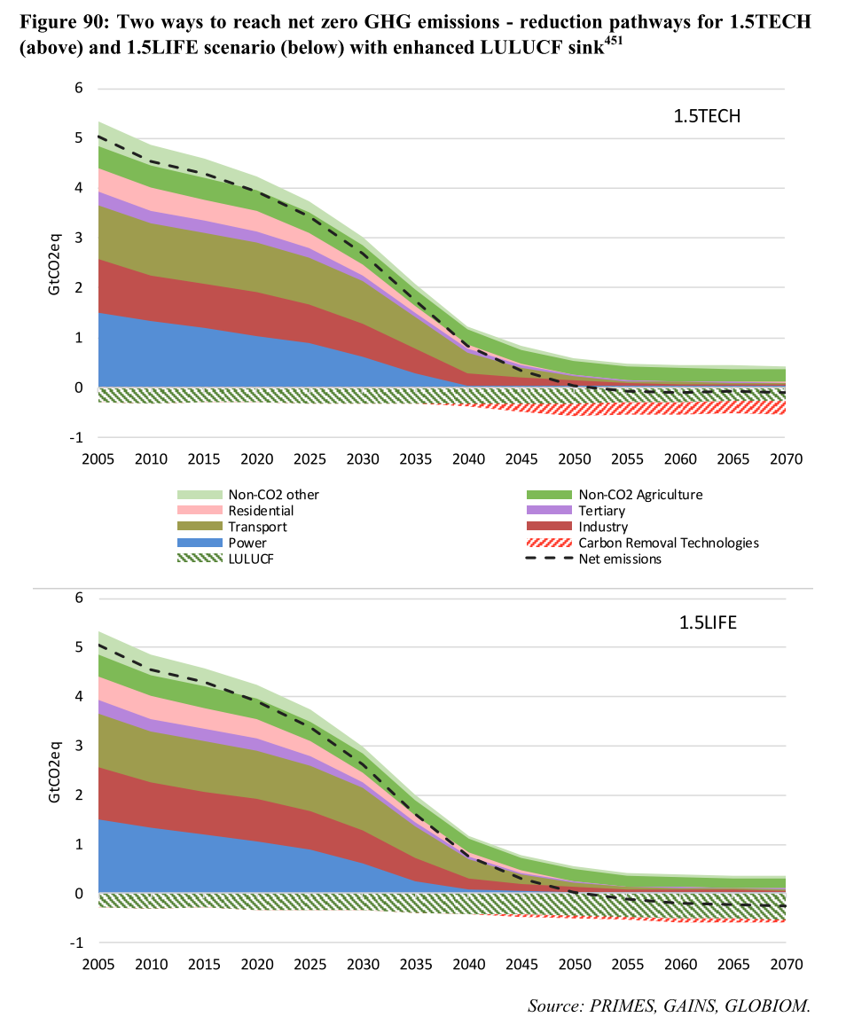
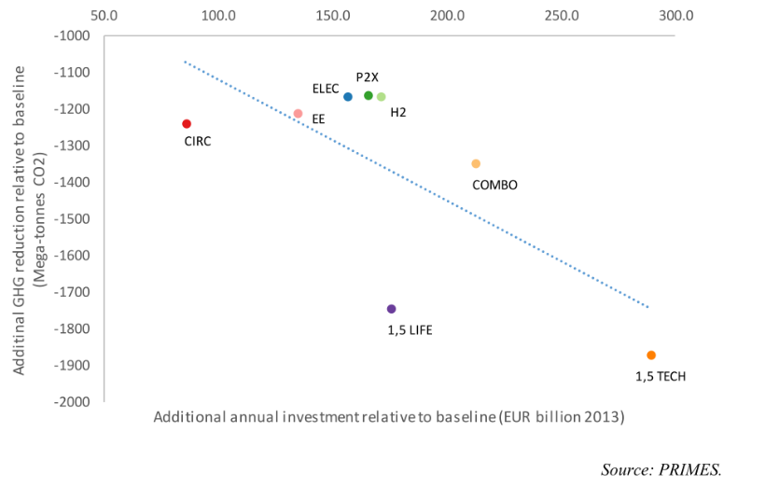
Transition : The EU plan
+1.5°C target
COP21 plus SP1.5 by IPCC
Global zero net GHG economy by 2070
Negative GHG [-20GtCO2eq, 0] emissions after 2070
« geophysically » feasible, limiting damages (from +2°C) but implying rapid and decisive movement into transition
Differentiated responsability
+2°C target likely, demanding anyway
Global zero net economy by 2100
Current (COP21) INDCs hitting over +3°C (Climatetracker, IPCC)
EC nov. 2018, “Clean planet for all”
Update of the roadmap to meet +1.5°C: znCO2eq in 2050 (from 4.3GtCO2eq in 2017)
1.5TECH
Decarbonization of energy supply (RNW); electrification (H2 ; biofuel as well); demand management; electricity storage
Transport and building electrification (or RNW) and efficiency
CCS (and other similar techs)
1.5LIFE – a revolution
Change in behaviour (diet, plane to train shift, car to bike shift, improved city planning, lower heating and cooling demand, widespread recycling)
Incentives to land sinks (as opposed to CCS) – forest, biomass, agriculture SCS

Slide 5
The EU plan : costs
EU wide | +1.5°C | +2°C | Source
Macro monetary costs
Additional investment (to baseline*) | $$180−300b€/y$$ | $$150−200b€/y$$ | EC « Clean planet for all » (2018)
Damages Exclude habitat losses | (well below +2°C damages) | $$140b€/y$$ | PESETA IV study report (2023)
International transfers | $$100b€/y$$ | $$50−100b€/y$$ | COP21-26 pledges+US retractation
Stranded assets Personal cars Coal | (increases with delayed transition) $300b€$ as a capital loss, $10b€/y$ $$5−10b€/y$$ | (well below +1.5°C stranded assets) | Authors’ evaluation** EC 2019
Migration | Well below +2°C | $10b€/y$ per million migrants | Authors’ evaluation**
Behavior curbing
Deadweight loss carbon pricing Distributional cost | $$80b€/y$$ Carbon price of $300€/tCO2$ fully compensated for the lower half income bracket $→$ $\sim 500b€/y$ initial transfer $50b€/y$ from 2050 |  | Authors’ evaluation** Authors’ evaluation**
Co benefits
Air pollution health effect Diet and chemicals health effect Ease of eco anxiety Sense of Justice | Based on SLV No monetary evaluation No monetary evaluation No monetary evaluation | equivalent or lower lower equivalent equivalent or higher | PESETA IV study report (2023)
Macro stimulus benefits | Minor compared to year costs |  | Authors’ review
*pathway udpated (EU REF 2016). June 2018 2030 targets are supposed to be met.
**more or less back of the enveloppe evaluation, order of magnitude only. See paper for hypothesis and calibration.

Slide 6
The EU example : the time factor
The transition has to be achieved by 2050
Acceleration in the next 20 years
long (+30 years) and then stand (for ever)
All techs are neither available nor scale nor cost proven
From electric/H2 cars, CCS or NET
Failure is not an option, mistakes are inevitable: likely to push cost up
Delays will translate in stranded assets value (and distributional issues)
1.5LIFE+1.5TECH more likely to be necessary

Slide 7
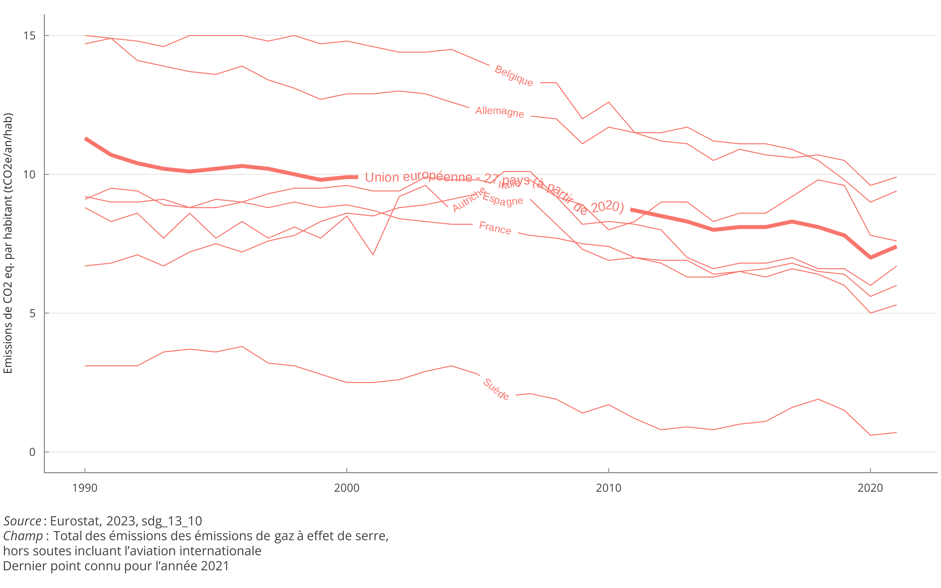
EU Curent Emissions

Slide 8
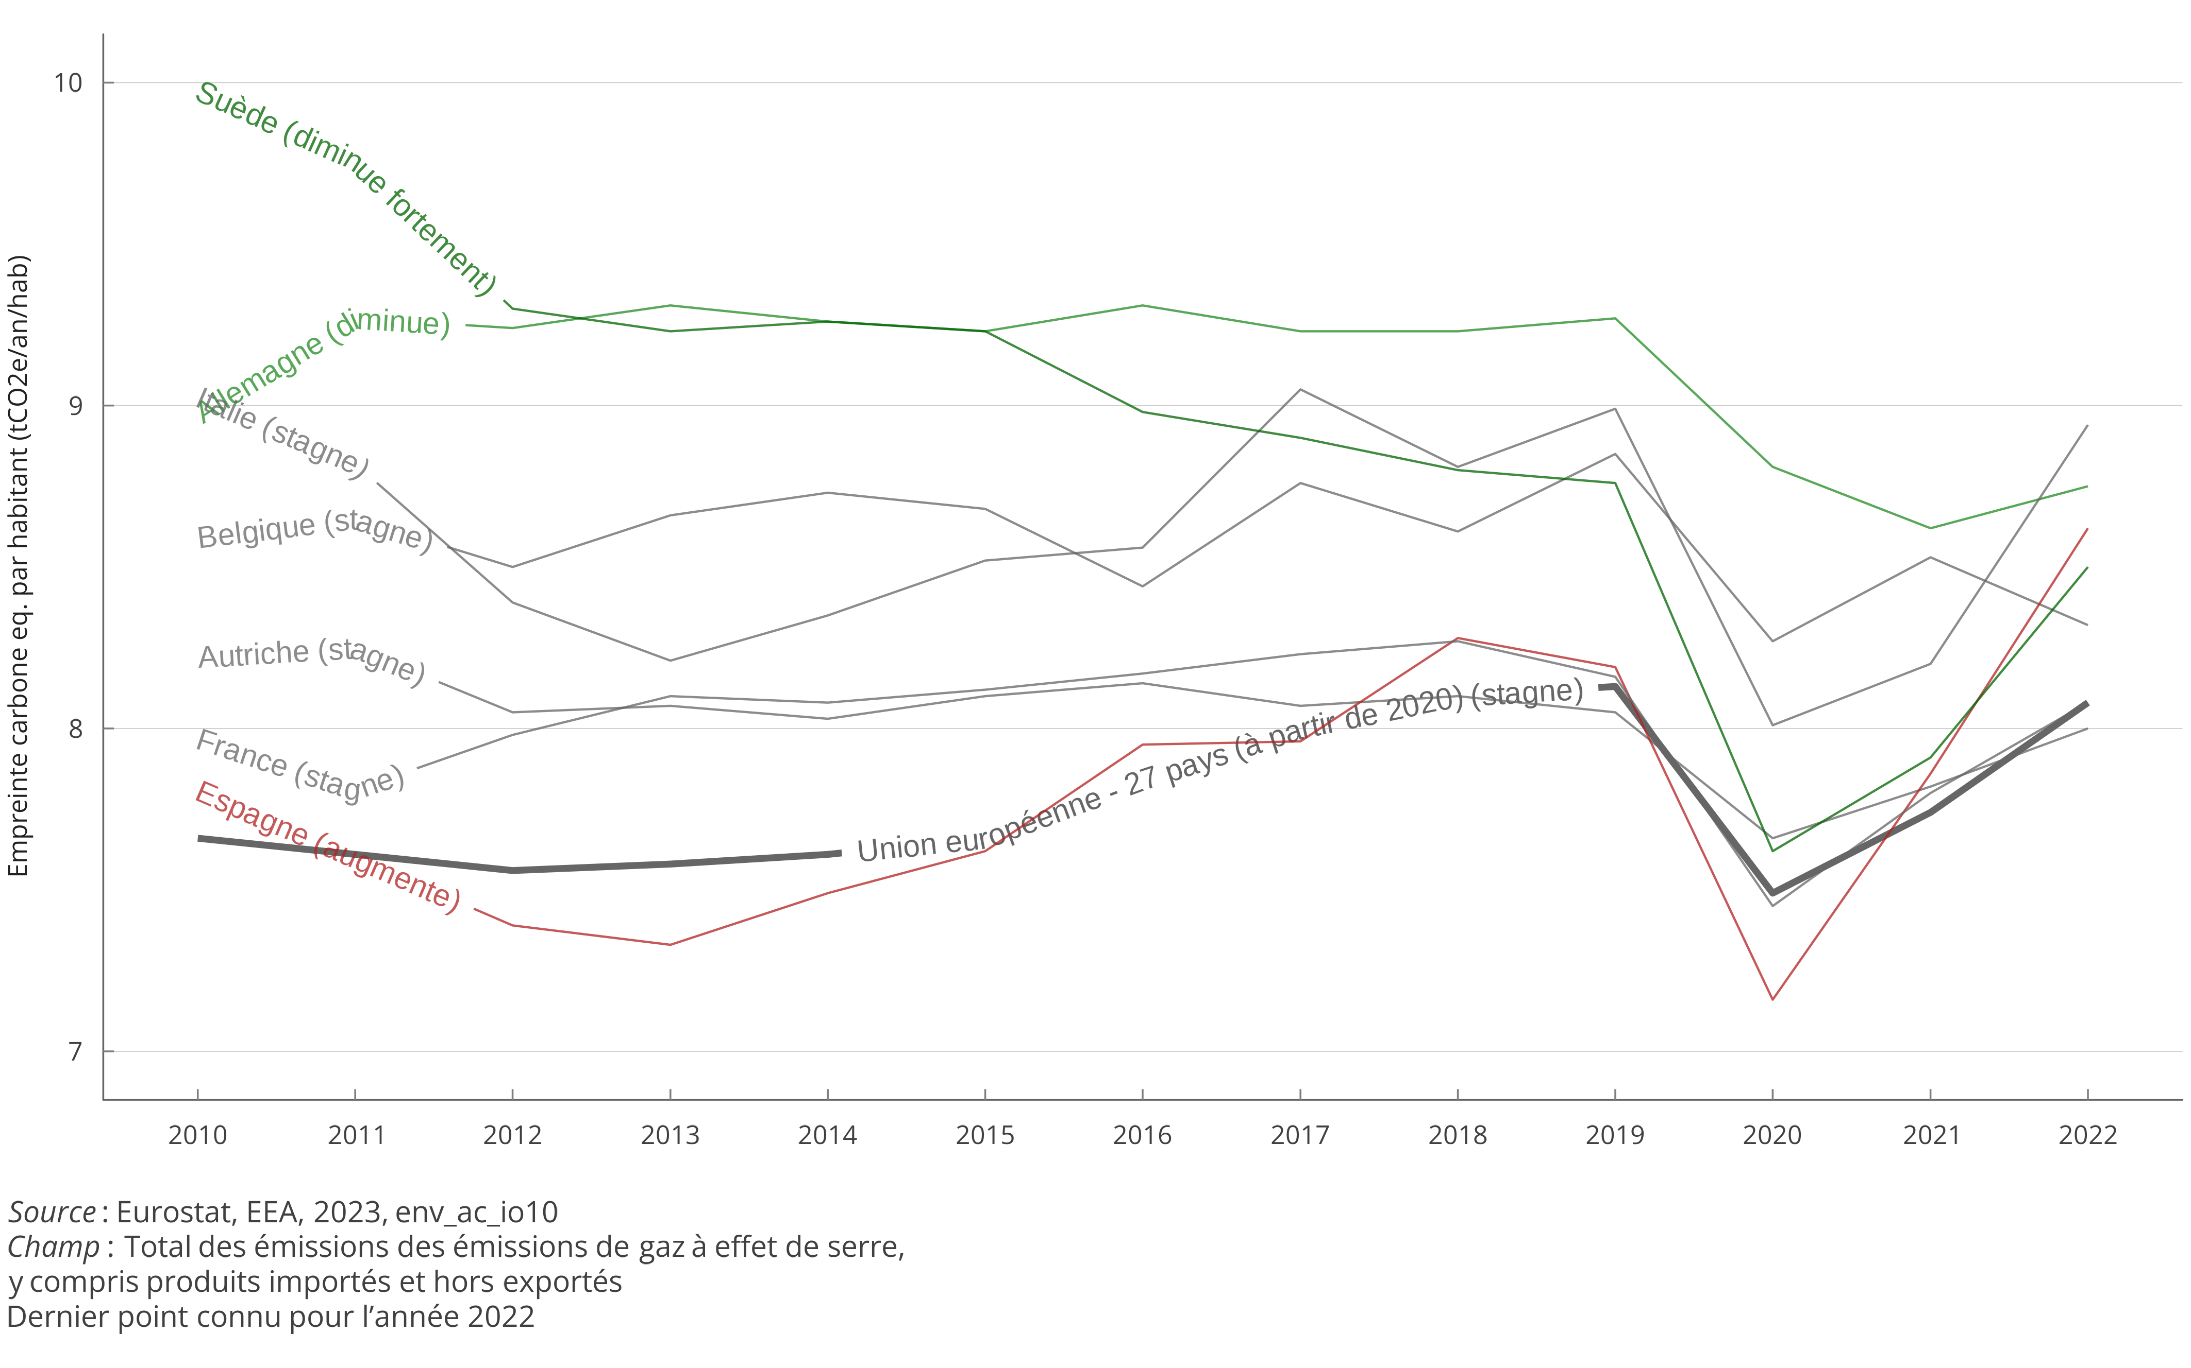
Footprint is higher and decreases slowly

Slide 9
The EU example : the costs are likely underestimated, largely distributional

Slide 10
The EU plan : macroeconomic impacts of the energy transition
Transitioning to a low carbon economy has an impact on several macroeconomic dimensions:
Sectoral structure of the economy, with an impact on:
Employment, due to different labor intensity
Investment, due to different capital intensity
Energy consumption, due to different energy intensity
Trade balance, due to different propensity to import and export
e.g.: growth of renewable electricity production while fossil electricity production decreases leads to an increase in employment since renewables are more labour-intensive, and a reduction of fossil fuel imports.
Overall level of investment
Achieving the Paris goals require a significant increase in investments in energy-related infrastructure
Depending on the funding source, this need not result in the crowding out of other investments
With limited crowding out, the increase in aggregate investments yields a direct keynesian impact
Tax system
Environmentally motivated taxation (e.g. carbon tax) can substitute for existing tax on labor, production or consumption
Environmental taxation can be less distortionary than the existing taxes it replaces
Competitiveness
In a non-cooperative setting, increasing energy costs can degrade competitiveness, particularly in the industry
This can be mitigated by implementing border carbon adjustments

Slide 11
Change in behaviour is well driven by prices, price of energy has been low

Slide 12
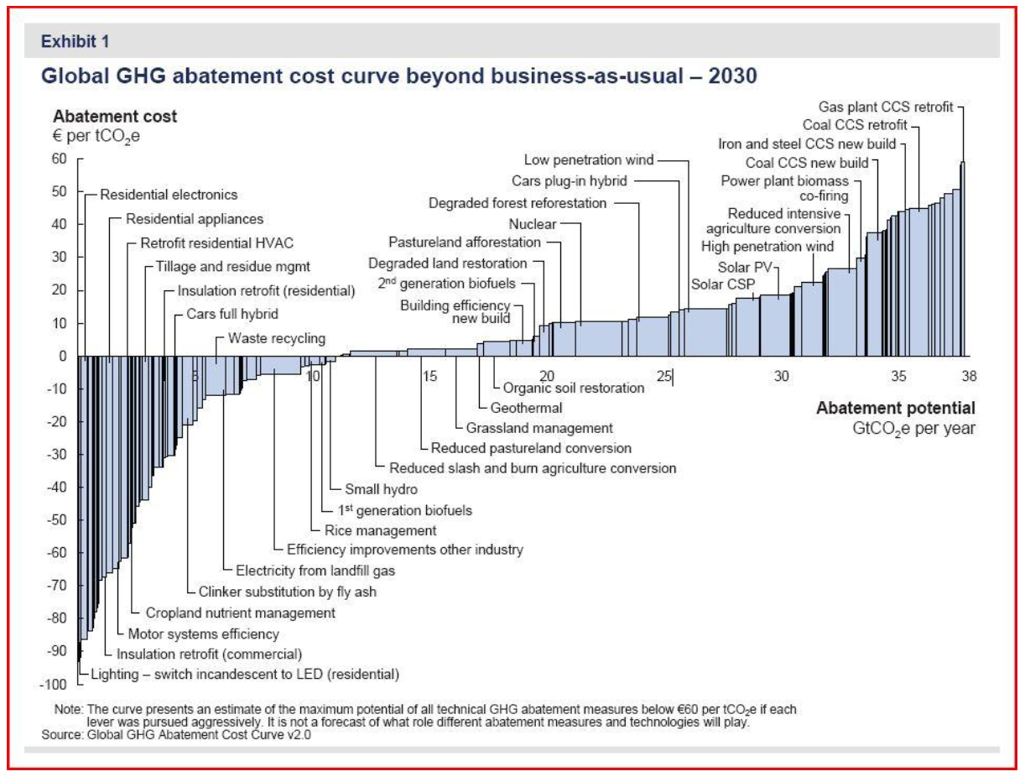
Finding the right price : McKinsey Abatement Curve

Slide 13
The Green Deal
2019 : In an EU parliament with a complex coalition, the Green Deal is the focal point of EU policy
A big surprise
“Green deal” expression due to Thomas Friedman’s tribune in NYT, 2007 : a way to unite everyone around a common goal
Based on COP21 SR1.5°C ; based on Commission “Clean Planet for All”
Proposed as the main norm for EU : commitment to net carbon neutral economy by 2050, do no significant harm with review of all regulations
In the meantime several large scale events have tested the Green Deal vraisemblance : Covid, Invasion of Ukraine by Russia, IRA
2023 : last months of the Von der Leyen Commission, most of the Green Deal “Climate” texts have been voted
SUR directive rejected (November 2023) after intense battle/lobbying
No deal on biodiversity/farming/”farm to fork” and end of discussions, no text will be submitted before the next commission
The coalition is broken, PPE not willing to pursue, supporting farmers against ecology
Various movement in Europe (NLD, RO, PL, FR, DEU) even before the Green Deal has any impact

Slide 14
Review of texts adopted
Regulation | Date | Comments
EU emission trading system Système d’échange de quota européen | Market stability reserve Mars 2023 Revision of EU ETS avril 2023 | Extension au transport maritime, réduction des allocations gratuites, mécanisme de compensation pour l’aviation Extension de l’ETS (ETS2) aux bâtiments (dont le résidentiel) et aux transports routiers (lien)
Social Climate Fund Fond social pour le Climat | Régulation adoptée en avril 2023 | Mécanisme de soutien pour les ménages et les petites entreprises de la hausse du prix du carbone (lien)
Carbon Border Ajustement Mechanism Mécanisme d’ajustement carbone aux frontières | Régulation adoptée en avril 2023 | Concentré sur certains secteurs, induit une taxation des importations en fonction du contenu en CO₂ (lien)
Effort Sharing Regulation | Régulation adoptée en mars 2023 | Réparti les réductions d’émissions entre les états membres en fonction d’une clef principalement PIB par tête (lien)
LULUCF (Land Use Land Use Change and Forestry) Puits de carbone | Régulation adoptée en mars 2023 | Accroit les objectifs en matière de puits de carbone (lien)
CO₂ emission standards for cars and vans | Régulation adoptée en mars 2023 | Réduit progressivement les émissions de CO₂ pour les véhicules, impose les véhicules zéro émission en 2035 (lien)
Reducing methane emission in the energy sector | Pas de régulation encore adoptée | Mesure et réduction des émissions de méthane indirecte du secteur de l’énergie (lien)
Sustainable Aviation Fuels (Refuel EU) | Régulation adoptée en octobre 2023 | Utilisation de carburants à moindre émissions dans l’aviation (lien)
Decarbonised fuels in shipping | Régulation adoptée en juillet 2023 | Utilisation de carburants à moindre émissions dans le transport maritime (lien)
Alternative fuels infrastructure | Régulation adoptée en juillet 2023 | Infrastructures de recharge (ou hydrogène) (lien)
Renewable Energy | Révision de la directive « Energie renouvelable » octobre 2023 | Augmente les ambitions d’énergies renouvelables en 2030 à au moins 40% (32% auparavant) (lien)
Energy efficiency | Révision de la directive « Efficacité énergétique » en juillet 2023 | Réduction de 11,7% de la consommation d’énergie finale en 2030 (lien)
Energy performance of buildings | Directive non encore adoptée ou révisée | Zéro émission pour les nouveaux bâtiments en 2030, pour tous les bâtiments en 2050 (lien)
Hydrogen and decarbonised gas market package | Directives et régulations non encore adoptées ou révisées | Organisation d’un marché de l’hydrogène, extension du mécanisme d’achat joint du gas. (lien)
Energy taxation | Directive non encore adoptée ou révisée | Alignement des taxations des produits énergétiques et de l’électricité sur les objectifs climat (lien)

Slide 15
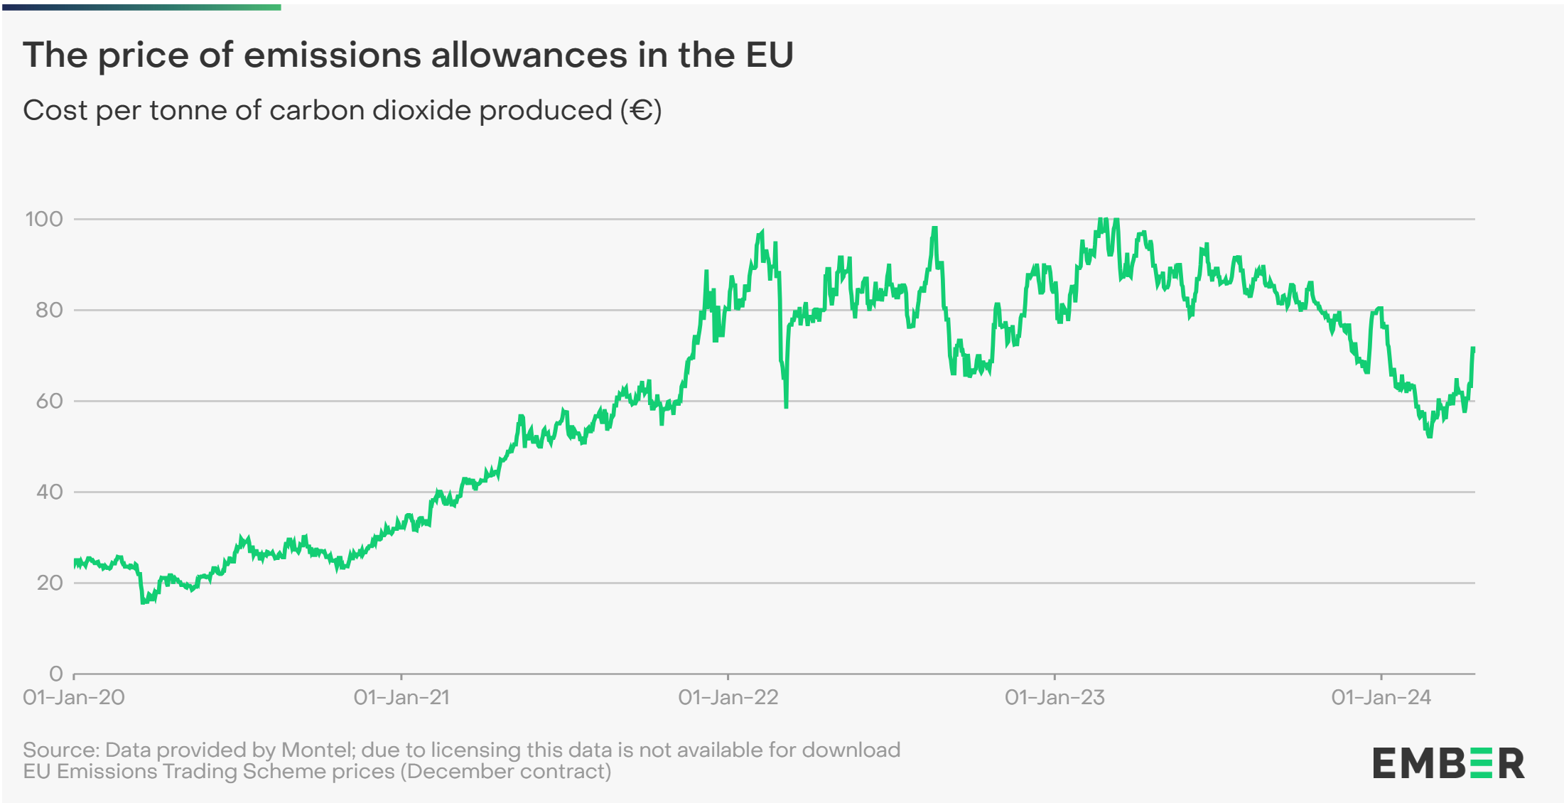
EU ETS remains an important pillar

Slide 16
S10. Economics of Environnement Conclusion II
Xavier Timbeau
xavier.timbeau@ofce.sciences-po.fr

Slide 17
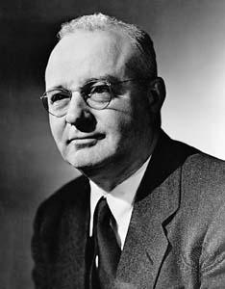
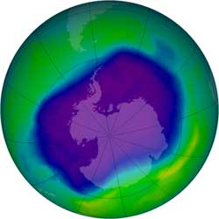
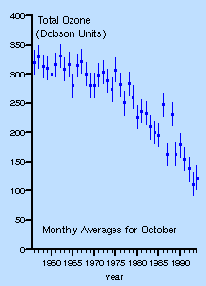
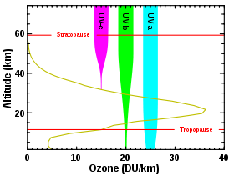
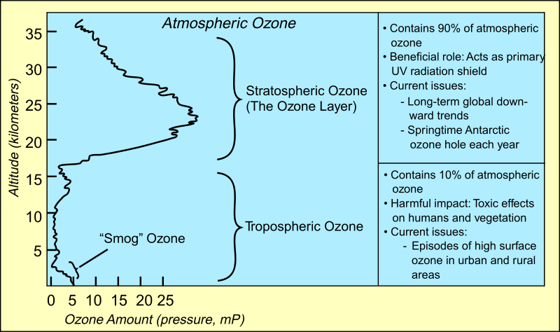
The ozone Hole and the Montreal Protocol
1930: Thomas Midgley invents freon
HCFC&CFC, produced by DuPont de Nemours
Neutral gaz, no corrosion, not active, not toxic, highly efficient to carry heat (compression/decompression cycles)
Largely used for refrigeration (fridges, air cooler), solvent, fire extinguisher, spray propelant, plastic foam propulsion
But : interact with O₃ and UV, and destroy it in the upper layer of atmosphere
O₃ layer blocks 97-99% of UV radiation
mostly UV-a and b lethal radiation, Dobson discovered this in the 30-50’s
1985: measure of the ozone layer display a large hole (over Antarctic)
Farman, Nature ; Rowland&Molina had found the mecanism in 1974
25y. of O₃ hole could have caused 1 to 2 millions skin cancers
Around 200 000 victims in the US up to 2040, according to NASA
http://www.nasa.gov/vision/earth/lookingatearth/ozone_record.html

Slide 18
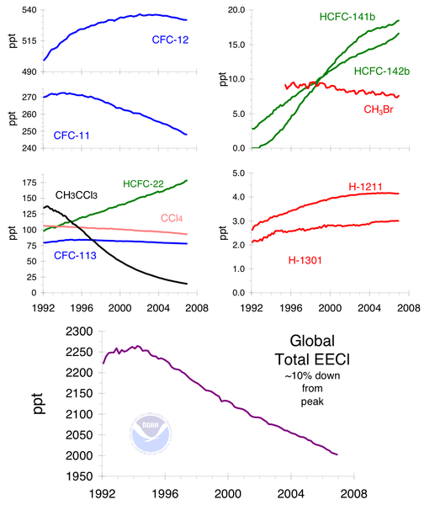
The montreal protocol
1985: Vienna convention (20 countries)
1985-1987: strong action from CFC lobbies
DuPont, 1987 we believe that there is no immediate crisis that demands unilateral regulation
1987: Montreal protocol ban use of CFC (immediate) and HCFC (to come) in most of the applications
196 states, including USA
Revised 7 times, last revision being Bejing in 1999
Phasing out of CFC production and consumption by 1996,
HCFC levels freezed by 2013 (transitory substitution), starting reduction by 2015
Multilateral fund for the Implementation of the Montreal Protocol
US$ 2.1 billions for countries with less than 0.3kg/cap/year ODS consumption
147/196 are potential receivers from the fund
It worked!
It is expected than ozone hole will disapear in 2045-2050
wouldn’t it, we’ll be all dead (or nearly)

Slide 19
Brainstorming session
Xavier Timbeau
xavier.timbeau@ofce.sciences-po.fr

